Slide 1
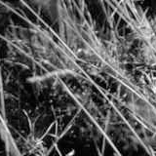
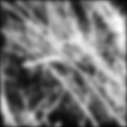
Linear Filtering
CS 678
Spring 2018

Slide 2
Outline
Linear filtering
Box filter vs. Gaussian filter
Median filter
Gaussian and Laplacian pyramids
Sharpening images
Some slides from Lazebnik

Slide 3
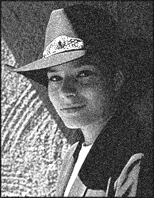


Motivation: Noise reduction
Given a camera and a still scene, how can you reduce noise?
Take lots of images and average them!
What’s the next best thing?
Source: S. Seitz
Notes:
Answer: take lots of images, average them

Slide 4

Moving average
Let’s replace each pixel with a weighted average of its neighborhood
The weights are called the filter kernel
What are the weights for a 3x3 moving average?
1
1
1
1
1
1
1
1
1
“box filter”
Source: D. Lowe

Slide 5
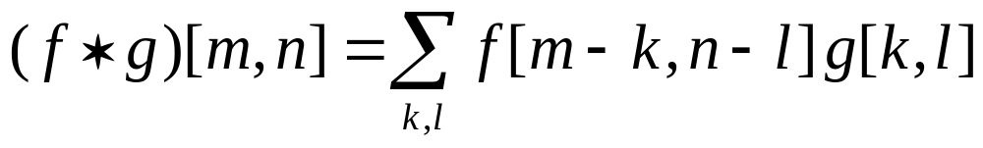


Defining convolution
Let f be the image and g be the kernel. The output of convolving f with g is denoted f * g.
f
Convention: kernel is “flipped”
MATLAB: conv2 vs. filter2 (also imfilter)
Source: F. Durand

Slide 6
Key properties
Linearity: filter(f₁ + f₂ ) = filter(f₁) + filter(f₂)
Shift invariance: same behavior regardless of pixel location: filter(shift(f)) = shift(filter(f))
Theoretical result: any linear shift-invariant operator can be represented as a convolution

Slide 7
Properties in more detail
Commutative: a * b = b * a
  Conceptually no difference between filter and signal
Associative: a * (b * c) = (a * b) * c
  Often apply several filters one after another: (((a * b₁) * b₂) * b₃)
  This is equivalent to applying one filter: a * (b₁ * b₂ * b₃)
Distributes over addition: a * (b + c) = (a * b) + (a * c)
Scalars factor out: ka * b = a * kb = k (a * b)
Identity: unit impulse e = […, 0, 0, 1, 0, 0, …],
a * e = a

Slide 8
Annoying details
What is the size of the output?
MATLAB: filter2(g, f, shape)
  shape = ‘full’: output size is sum of sizes of f and g
  shape = ‘same’: output size is same as f
  shape = ‘valid’: output size is difference of sizes of f and g
full
same
valid
g
g
g
g
f
f
f
g
g
g
g
g
g
g
g

Slide 9



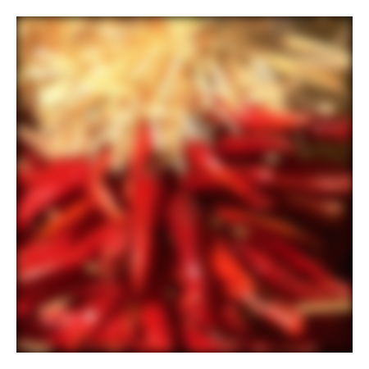


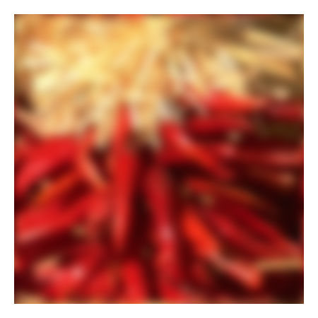






Annoying details
What about near the edge?
  the filter window falls off the edge of the image
  need to extrapolate
  methods:
    clip filter (black)
    wrap around
    copy edge
    reflect across edge
Source: S. Marschner

Slide 10
Annoying details
What about near the edge?
  the filter window falls off the edge of the image
  need to extrapolate
  methods (MATLAB):
    clip filter (black): imfilter(f, g, 0)
    wrap around: imfilter(f, g, ‘circular’)
    copy edge: imfilter(f, g, ‘replicate’)
    reflect across edge: imfilter(f, g, ‘symmetric’)
Source: S. Marschner

Slide 11
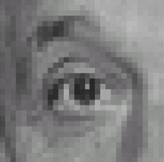
Practice with linear filters
0
0
0
?
0
1
0
0
0
0
Original
Source: D. Lowe

Slide 12
Practice with linear filters
0
0
0
0
1
0
0
0
0
Original
Filtered
(no change)
Source: D. Lowe

Slide 13
Practice with linear filters
0
0
0
?
0
0
1
0
0
0
Original
Source: D. Lowe

Slide 14
Practice with linear filters
0
0
0
0
0
1
0
0
0
Original
Shifted left
By 1 pixel
Source: D. Lowe

Slide 15
Practice with linear filters
1
1
1
?
1
1
1
1
1
1
Original
Source: D. Lowe

Slide 16
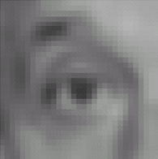
Practice with linear filters
1
1
1
1
1
1
1
1
1
Original
Blur (with a
box filter)
Source: D. Lowe

Slide 17
Practice with linear filters
0
0
0
-
1
1
1
?
0
2
0
1
1
1
0
0
0
1
1
1
(Note that filter sums to 1)
Original
Source: D. Lowe

Slide 18
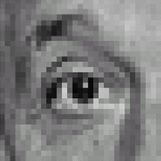
Practice with linear filters
0
0
0
-
1
1
1
0
2
0
1
1
1
0
0
0
1
1
1
Original
Sharpening filter
  Accentuates differences with local average
Source: D. Lowe

Slide 19
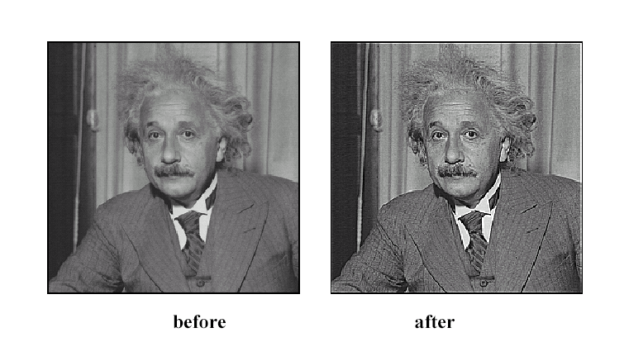
Sharpening
Source: D. Lowe

Slide 20

Smoothing with box filter revisited
Smoothing with an average actually doesn’t compare at all well with a defocused lens
Most obvious difference is that a single point of light viewed in a defocused lens looks like a fuzzy blob; but the averaging process would give a little square
Source: D. Forsyth
Notes:
I always walk through the argument on the left rather carefully; it gives some insight into the
significance of impulse responses or point spread functions.

Slide 21
Smoothing with box filter revisited
Smoothing with an average actually doesn’t compare at all well with a defocused lens
Most obvious difference is that a single point of light viewed in a defocused lens looks like a fuzzy blob; but the averaging process would give a little square
Better idea: to eliminate edge effects, weight contribution of neighborhood pixels according to their closeness to the center, like so:
“fuzzy blob”
Notes:
I always walk through the argument on the left rather carefully; it gives some insight into the
significance of impulse responses or point spread functions.

Slide 22
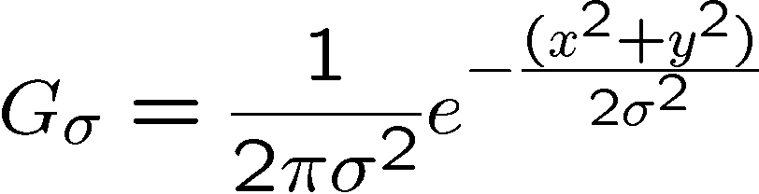
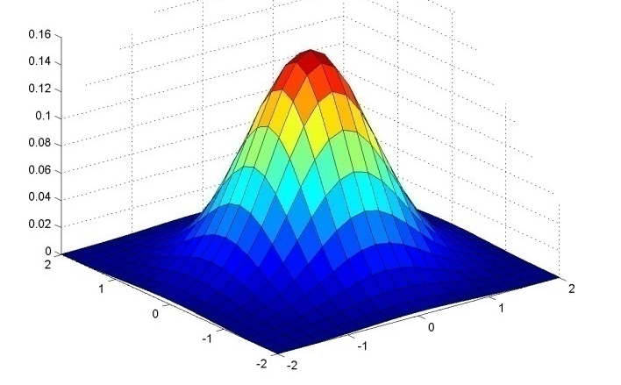
Gaussian Kernel
0.003 0.013 0.022 0.013 0.003
0.013 0.059 0.097 0.059 0.013
0.022 0.097 0.159 0.097 0.022
0.013 0.059 0.097 0.059 0.013
0.003 0.013 0.022 0.013 0.003
5 x 5, σ = 1
Constant factor at front makes volume sum to 1 (can be ignored, as we should re-normalize weights to sum to 1 in any case)
Source: C. Rasmussen

Slide 23
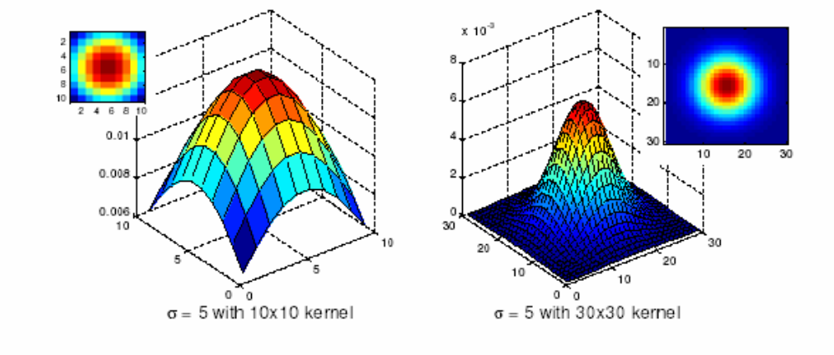
Choosing kernel width
Gaussian filters have infinite support, but discrete filters use finite kernels
Source: K. Grauman

Slide 24
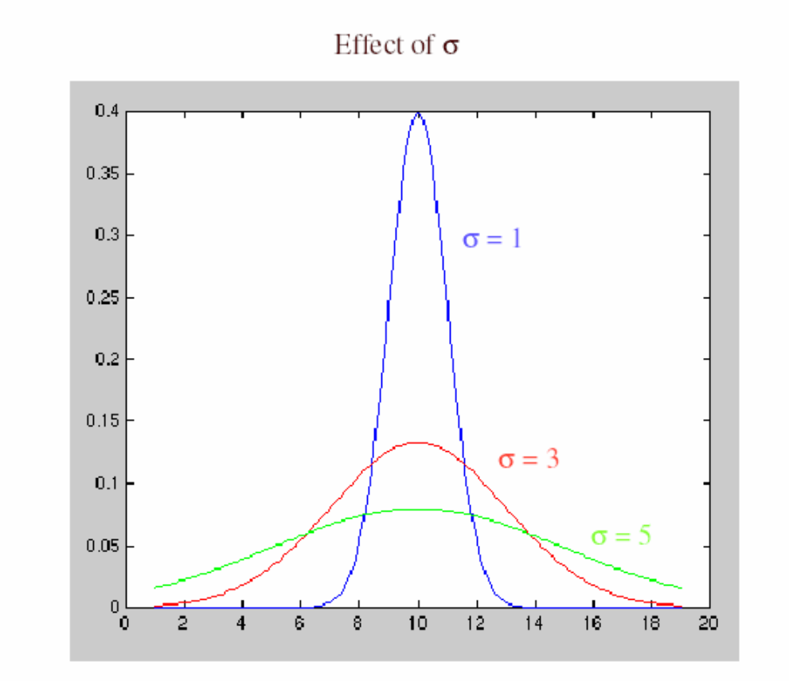
Choosing kernel width
Rule of thumb: set filter half-width to about
3 σ

Slide 25
Example: Smoothing with a Gaussian

Slide 26
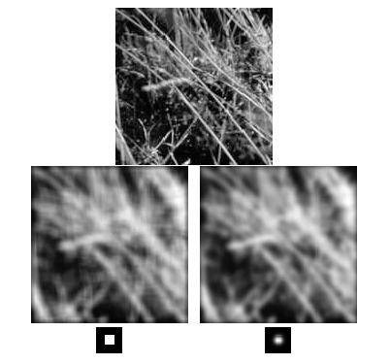
Mean vs. Gaussian filtering

Slide 27
Gaussian filters
Remove “high-frequency” components from the image (low-pass filter)
Convolution with self is another Gaussian
  So can smooth with small-width kernel, repeat, and get same result as larger-width kernel would have
  Convolving two times with Gaussian kernel of width σ is same as convolving once with kernel of width σ√2
Separable kernel
  Factors into product of two 1D Gaussians
Source: K. Grauman
Notes:
Linear vs. quadratic in mask size

Slide 28
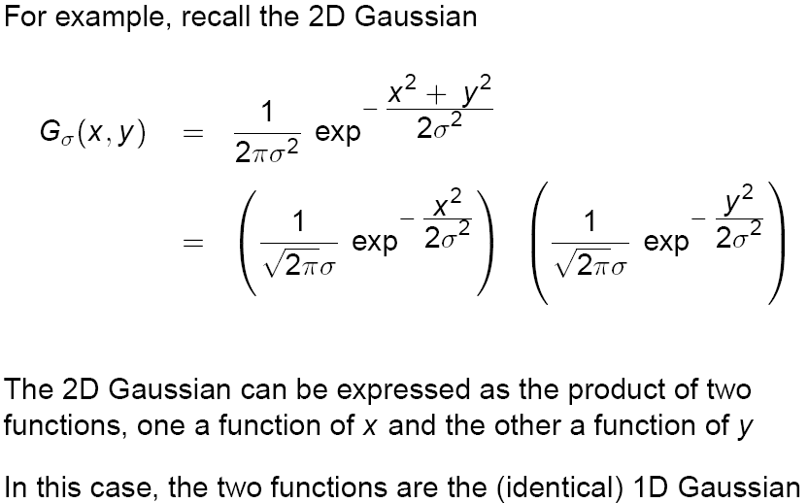
Separability of the Gaussian filter
Source: D. Lowe

Slide 29
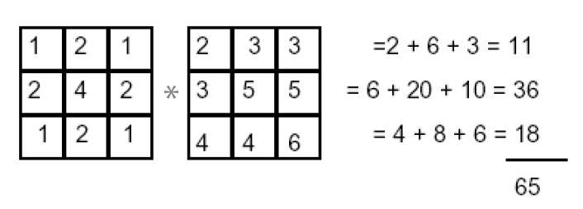
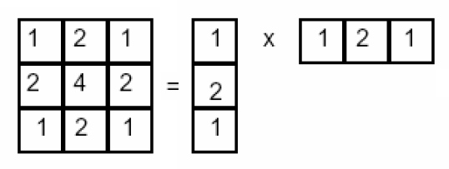
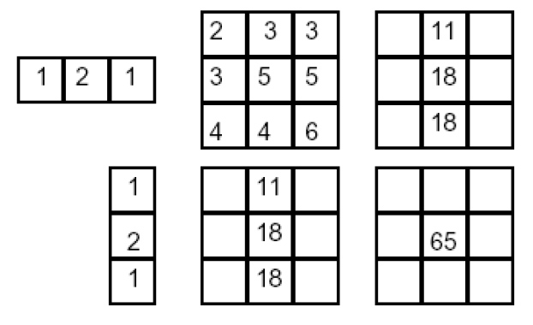
Separability example
2D convolution
(center location only)
The filter factors
into a product of 1D
filters:
Perform convolution
along rows:
*
=
Followed by convolution
along the remaining column:
*
=
Source: K. Grauman

Slide 30
Separability
Why is separability useful in practice?

Slide 31
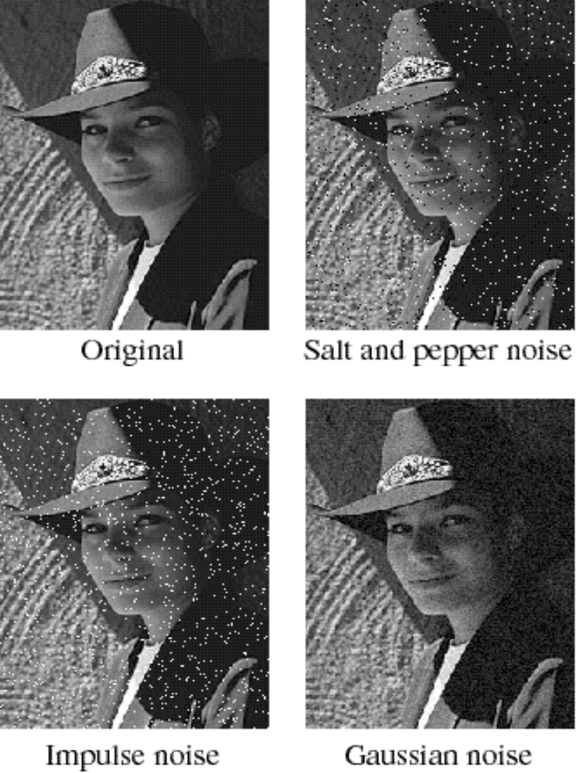
Noise
Salt and pepper noise: contains random occurrences of black and white pixels
Impulse noise: contains random occurrences of white pixels
Gaussian noise: variations in intensity drawn from a Gaussian normal distribution
Source: S. Seitz
Notes:
Salt and pepper and impulse noise can be due to transmission errors (e.g., from deep space probe), dead CCD pixels, specks on lens

Slide 32
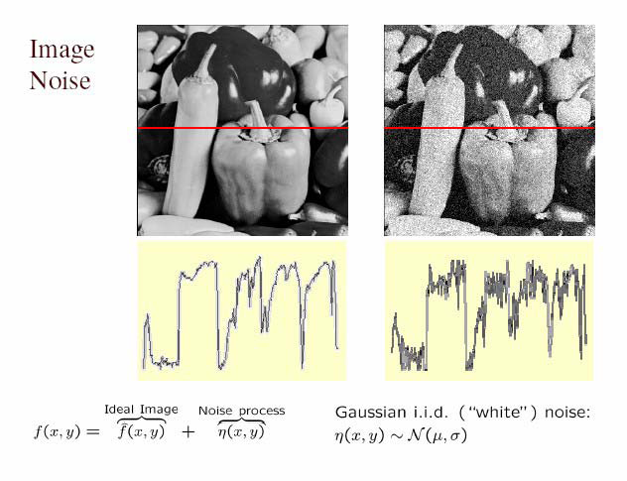
Gaussian noise
Mathematical model: sum of many independent factors
Good for small standard deviations
Assumption: independent, zero-mean noise
Source: M. Hebert

Slide 33
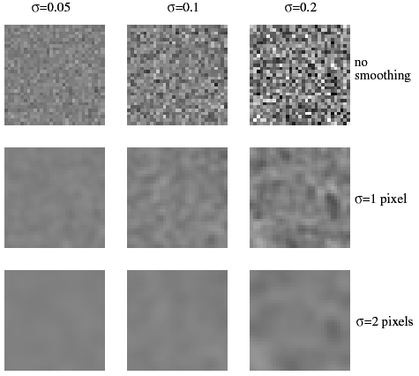
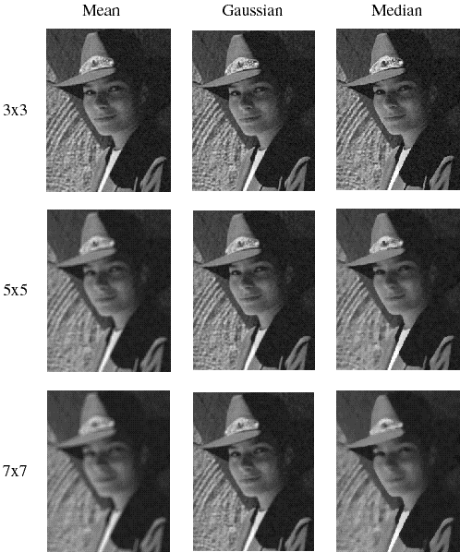
Reducing Gaussian noise
Smoothing with larger standard deviations suppresses noise, but also blurs the image

Slide 34
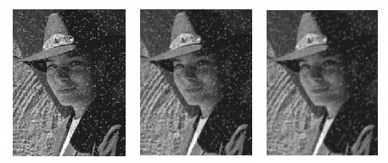
Reducing salt-and-pepper noise
3x3
5x5
7x7
What’s wrong with the results?

Slide 35
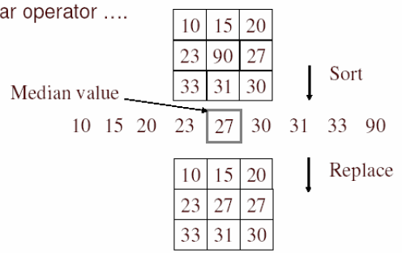
Alternative idea: Median filtering
A median filter operates over a window by selecting the median intensity in the window
Is median filtering linear?
Source: K. Grauman
Notes:
Better at salt’n’pepper noise
Not convolution: try a region with 1’s and a 2, and then 1’s and a 3

Slide 36
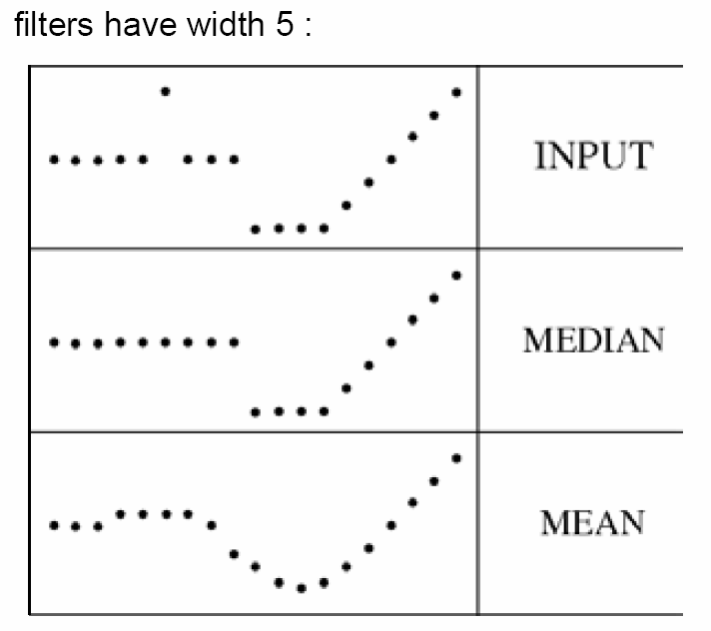
Median filter
What advantage does median filtering have over Gaussian filtering?
  Robustness to outliers
Source: K. Grauman

Slide 37
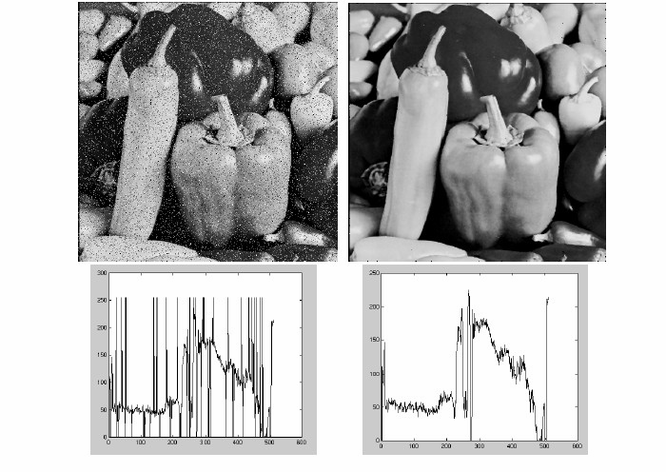
Median filter
Salt-and-pepper noise
Median filtered
MATLAB: medfilt2(image, [h w])
Source: M. Hebert

Slide 38
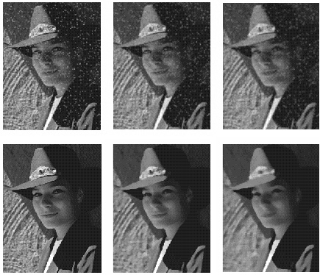
Median vs. Gaussian filtering
3x3
5x5
7x7
Gaussian
Median

Slide 39
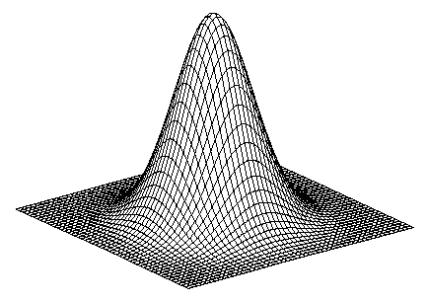
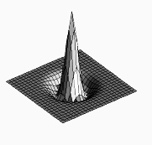

Unsharp mask filter
image
blurred
image
unit impulse
(identity)
unit impulse
Gaussian
Laplacian of Gaussian
Notes:
f + a(f - f * g) = (1+a)f-af*g = f*((1+a)e-g)

